Slide 1
Background & Relative Work | 06
Background & Relative Work : Models & Tools
1
Large Language Models
2
RAG
3
MCP
4
Multi-Agent(LangGraph)
LUXIA: Korean - specialized
Static RAG: Retrieves pre-stored policy and resume datasets
Standardized interface for connecting external APIs and tools
Router Agent: analyzes user intent and assigns tasks
GPT-4o-mini: Response Evaluation
Dynamic RAG: Retrieves real-time business reports from DART
Limitations of Traditional LLM:
1. Cannot access real-time external APIs or databases
2. Cannot directly interact with internal systems or tools
3. Cannot directly call APIs
Sub-Agents: Policy Agent, Job Agent, Resume/Interview Agent, Calendar Agent
Limitations of Traditional LLM: Hallucination, Lack of specificity, Outdated knowledge
Gemini 2.0 Flash: Handling long-context
Advantages of RAG:
Improving factual accuracy, more specific and context-aware responses, Keeping information up-to-date without retraining the model
Each agent can run independently, while results are integrated around the user goal
Advantages of MCP: Enables standardized access to external APIs and tools

Slide 2
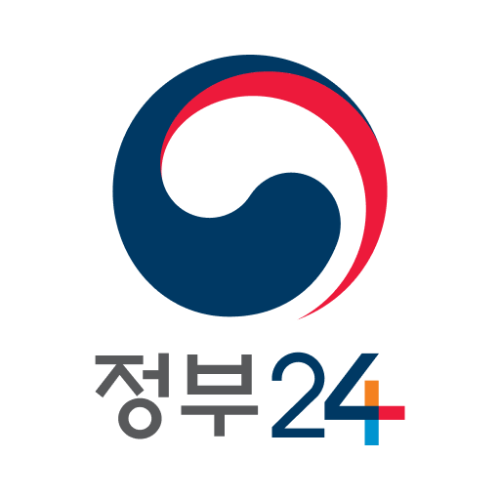


Background & Relative Work | 03
Background & Relative Work : Improvement over Existing Services
Existing Services
YouthPath Improvement
- Provides personalized policy recommendations based on detailed user inputs
Government24
- Clearly identifies eligibility and suggests application strategies
ChatGPT
- Uses RAG and MCP for real-time retrieval and updated information
- Provides resume writing guidelines based on company reports and job postings
JOBKOREA
- Automatically synchronizes policy application deadlines and sends reminders
Personal Calendar

